Slide 1

Salvatore DiLeo & Louis Sanchez ~present~
for the iPhone

Slide 2
KenKen is a logic and arithmetic based puzzle game in which you fill a square grid of boxes with numbers. A board consists of n² boxes, arranged in an n×n grid. Each box is filled with a number, from 1 to n, abiding by a few simple rules:
The numbers cannot repeat in any row or column.
The numbers in each heavily outlined set of boxes (cages) must combine (in any order) using the mathematical operation indicated to form the target number shown in the top corner of the cage.
Cages with one box are just filled with the target number.
A number can repeat within a cage as long as it is not in the same row or column.
Board sizes range from 4×4 to 9×9. Sizes outside that range are not really used, although possible. The largest cage sizes seem to be 3 for 4×4 and 5×5 boards, 4 for 6×6 and 7×7 boards, and 5 for 8×8 and 9×9 boards. The mathematical operators used are addition, subtraction, multiplication, and division. Also, boxes are not locked once a number is entered, so mistakes can be corrected.

Slide 3
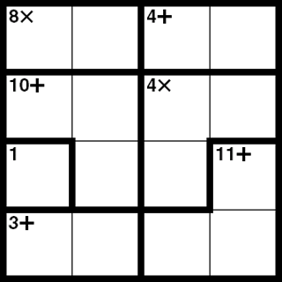
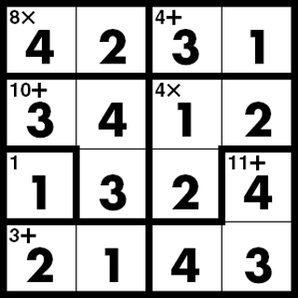
An Example 4×4 Board
Blank
Solved

Slide 4
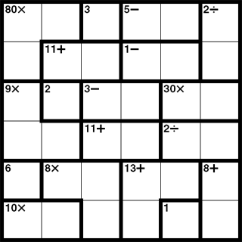
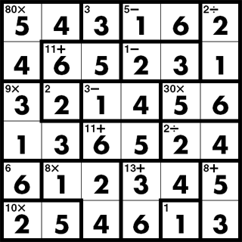
An Example 6×6 Board
Blank
Solved

Slide 5
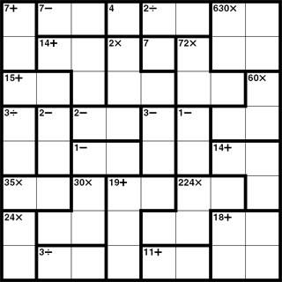
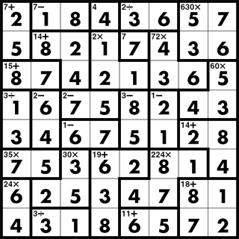
An Example 8×8 Board
Blank
Solved

Slide 6
Intended Audience:
Anyone who enjoys puzzles or logic-based games.
Technical Challenges and Resources Needed:
The main challenges will be to create a random board generator that creates sensible boards, to enable the user to save his current board for completion later, and to have the cages, target number, and indicated mathematical operation display properly no matter what random board is generated. The best way of approaching this would be to create a custom view for the “box” element of the puzzle. This view would have properties for each feature a box may have: a number, a target number, a mathematical operator, and any combination of the 4 darkened borders.
Overall Logic:
The grid of numbers would be created first, with the cages and their associated mathematical operations created after. Each number belongs to a specific box, which belongs to a specific cage, which in turn belongs to the board as a whole.
Member Responsibilities:
We will both work on all components of the project together, pair programming if you will, so there are no split responsibilities.

Slide 7
By Tuesday, 04 May, we plan to have the following implemented:
A random board generator, creating sensible boards for at least the 4×4 grid.
The ability to save the current board for completion later.
The ability to reveal the solution for the current board.
A notification system that warns the user if he places a number in an impossible position (e.g., placing a number in the same row or column a second time).
A clean, simple, and pleasing user interface.

Slide 8
Using the iPhone’s Unique Features
We plan to use some of the cool features the iPhone has to offer, such as its touch capabilities and accelerometer. Here are some of our ideas:
Tapping a box once will “open” it. Then, choosing the number would be done by sliding one’s finger across the screen in any direction. The point of origin of the sliding action would be 1 and some further distance would be n. Lifting the finger would enter the number shown.
Shaking the iPhone could clear the board, generate a new board, or reveal the solution for the current board.
Double-tapping an individual box could reveal it’s number.

Slide 9
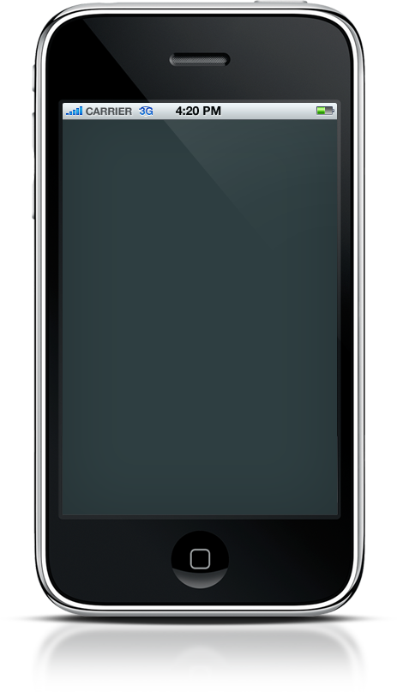

Mock-Ups of the Major Screens
KenKen
By: Salvatore DiLeo &
Louis Sanchez

Slide 10
Mock-Ups of the Major Screens

Slide 11
Possible Future Developments
Displaying a timer for the user and saving his best times.
Larger board sizes.
The ability to save multiple boards at once.
Thank You for Your Time!
Please comment and/or ask questions!

